Slide 1
FAIR USE NOTICE
The material used in this presentation i.e., pictures/graphs/text, etc. is solely intended for educational/teaching purpose, offered free of cost to the students for use under special circumstances of Online Education due to COVID-19 Lockdown situation and may include copyrighted material - the use of which may not have been specifically authorised by Copyright Owners. Its application constitutes Fair Use of any such copyrighted material as provided in globally accepted law of many countries. The contents of presentations are intended only for the attendees of the class being conducted by the presenter.

Slide 2
CLOUD COMPUTING
Notes:
Reference: Distributed Computing Principles and Applications by M.L.Liu
2

Slide 3
CONTENT
Parameters in RMI
Distributing RMI classes
Distributed Garbage Collection
Introduction to Java Naming and Directory Service (JNDI) and LDAP
RMI over IIOP
Differences between RMI and RMI-IIOP
CORBA
CORBA AND ORB

Slide 4
PARAMETERS IN RMI
You have seen that RMI supports method calls to remote objects. When these calls involve passing parameters or accepting a return value,
how does RMI transfer these between JVMs?
What semantics are used?
Does RMI support pass-by-value or pass-by-reference?
The answer depends on whether the parameters are primitive data types, objects, or remote objects

Slide 5
Parameters in a single JVM
Pass by value: When a parameter is passed to a method, the JVM makes a copy of the value, places the copy on the stack and then executes the method. Values returned from methods are also copies.
Pass by reference: The mechanics of passing an object as a parameter are more complex. Recall that an object resides in heap memory and is accessed through one or more reference variables. E.g. String s = "Test"; System.out.println(s);
In the example, a copy of reference variable s is made (increasing the reference count to the String object by one) and is placed on the stack. Inside the method, code uses the copy of the reference to access the object.

Slide 6
RMI Parameters: Primitive Parameters
Primitive data type when passed as a parameter to a remote method, the RMI system passes it by value
If a method returns a primitive data type, it is also returned to the calling JVM by value.
Values are passed between JVMs in a standard, machine-independent format.
This allows JVMs running on different platforms to communicate with each other reliably.

Slide 7
RMI Parameters: Object Parameters
When an object is passed to a remote method, RMI sends the object itself, not its reference, between JVMs.
It is the object that is passed by value, not the reference to the object.
Similarly, when a remote method returns an object, a copy of the whole object is returned to the calling program.
Unlike primitive data types, sending an object to a remote JVM is a nontrivial task. A Java object can be simple and self-contained, or it could refer to other Java objects in complex graph-like structure.
Because different JVMs do not share heap memory, RMI must send the referenced object and all objects it references. (Passing large object graphs can use a lot of CPU time and network bandwidth.)

Slide 8
RMI uses a technology called Object Serialization to transform an object into a linear format that can then be sent over the network wire.
Object serialization essentially flattens an object and any objects it references. Serialized objects can be de-serialized in the memory of the remote JVM and made ready for use by a Java program.

Slide 9
RMI Parameters: Remote Object Parameters
RMI introduces a third type of parameter to consider: remote objects.
As we have already seen, a client program can obtain a reference to a remote object through the RMI Registry program.
There is another way in which a client can obtain a remote reference, it can be returned to the client from a method call.

Slide 10
RMI Parameters: Remote Object Parameters
In the following code, the BankManager service getAccount() method is used to obtain a remote reference to an Account remote service.
BankManager bm;
Account a;
try {
bm = (BankManager) Naming.lookup( "rmi://BankServer /BankManagerService" );
a = bm.getAccount( "jGuru" ); // returns remote Account object reference
}
catch (RemoteException re) {
}

Slide 11
RMI Parameters: Remote Object Parameters
In the implementation of getAccount(), the method returns a (local) reference to the remote service.
AccountImpl getAccount(String accountName) {
// Code to find the matching account
AccountImpl ai = // return reference from search
return ail;
//AccountImpl class is a implementation class on server that extends UnicastRemoteObject
}
When a method returns a local reference to an exported remote object, RMI does not return that object. Instead, it substitutes another object (the remote proxy for that service) in the return stream.

Slide 12
DISTRIBUTING RMI CLASSES
To run an RMI application, the supporting class files must be placed in locations that can be found by the server and the clients.
For the server, the following classes must be available to its class loader:
Remote service interface definitions
Remote service implementations
Skeletons for the implementation classes (JDK 1.1 based servers only)
All other server classes
For the client, the following classes must be available to its class loader:
Remote service interface definitions
Stubs for the remote service implementation classes
All other client classes

Slide 13
DISTRIBUTED GARBAGE COLLECTION
We know the JVM has an automatic garbage collector that will reclaim the memory from any object that has been discarded by the running program.
Designing an efficient single-machine garbage collector is hard; designing a distributed garbage collector is very hard.
The RMI system provides a reference counting distributed garbage collection algorithm.
This system works by having the server keep track of which clients have requested access to remote objects running on the server. When a reference is made, the server marks the object as "dirty" and when a client drops the reference, it is marked as being "clean."
Notes:
13

Slide 14
The interface to the DGC (distributed garbage collector) is hidden in the stubs and skeletons layer.
In addition to the reference counting mechanism, a live client reference has a lease with a specified time.
If a client does not refresh the connection to the remote object before the lease term expires, the reference is considered to be dead and the remote object may be garbage collected.
The lease time is controlled by the system property java.rmi.dgc.leaseValue

Slide 15
INTRODUCTION TO JAVA NAMING AND DIRECTORY SERVICE (JNDI)
Naming and directory services play a vital role in intranets and the Internet by providing network-wide sharing of a variety of information about users, machines, services, and applications.
JNDI (Java Naming and Directory Interface) enables Java platform-based applications to access multiple naming and directory services.
JNDI is an API specified in Java technology that provides naming and directory functionality to applications written in the Java programming language.
In addition, JNDI provides methods for performing standard directory operations, such as associating attributes with objects and searching for objects using their attributes.

Slide 16
JNDI is also defined independent of any specific naming or directory service implementation. It enables applications to access different, possibly multiple, naming and directory services using a common API.
Different naming and directory service providers can be plugged in seamlessly behind this common API.

Slide 17
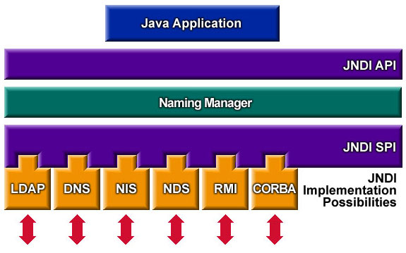
JNDI Architecture
JNDI enables Java technology-based applications to take advantage of information in a variety of existing naming and directory services, such as LDAP, NDS, DNS, and NIS, as well as enabling the applications to coexist with legacy software and systems.
Notes:
NIS: Network Information Service
NDS: Novell Directory Services
17

Slide 18
The JNDI architecture consists of an API (Application Programming Interface) and an SPI (Service Provider Interface).
Java applications use this API to access a variety of naming and directory services.
The SPI enables a variety of naming and directory services to be plugged in transparently, allowing the Java application using the API of the JNDI technology to access their services.
Notes:
The NamingManager class contains static methods that perform provider-related operations.

Slide 19
LDAP (Lightweight Directory Access Protocol)
LDAP, Lightweight Directory Access Protocol, is an Internet protocol that email and other programs use to look up information from a server.
"LDAP-aware" client programs can ask LDAP servers to look up entries in a wide variety of ways. LDAP servers index all the data in their entries, and "filters" may be used to select just the person or group you want, and return just the information you want.
LDAP is used to look up encryption certificates, pointers to printers and other services on a network, and provide "single signon" where one password for a user is shared between many services.

Slide 20
LDAP is appropriate for any kind of directory-like information, where fast lookups and less-frequent updates are the norm.
LDAP also defines: Permissions, set by the administrator to allow only certain people to access the LDAP database, and optionally keep certain data private.
Perhaps the biggest plus for LDAP is that your company can access the LDAP directory from almost any computing platform, from any one of the increasing number of readily available, LDAP-aware applications.

Slide 21
21
RMI Over IIOP
The RMI over IIOP Framework allows communication between Java applications and Non-Java applications.
RMI over IIOP (RMI-IIOP hereafter), developed jointly by IBM and Sun, is a new version of RMI (Remote Method Invocation) for IIOP (Internet Inter-ORB Protocol) that combines RMI's easy programming features with CORBA's interoperability.
RMI and CORBA have developed independently as distributed-objects programming models. RMI was introduced as a Java-based, easy-to-use programming model for distributed objects.
Notes:
21

Slide 22
CORBA (the Common Object Request Broker Architecture), defined by the OMG (Object Management Group), is a well-known distributed-object programming model that supports a number of languages.
The IIOP protocol connects CORBA products from different vendors, ensuring interoperability among them.
RMI-IIOP generates automatically IDL (Interface Definition Language) code that acts as the intermediary data types between the client and the server applications (even if both are written in Java).
It frees the developer from having to know another language (IDL)
It is slower, in general, than a similar RMI implementation.

Slide 23
23
RMI Over IIOP
RMI Over IIOP IDL usage:
Client request-
Client application could be Java
Java Data Types
are converted to
IDL data types
and sent to server
IDL Data Types
are converted to
server’ s language
data types
Server executes
its service and
returns any data
Client
IDL Data Types
are converted to
client ’ s language
data types (Java)
Server’ s language
Data Types
are converted to
IDL
data types
Notes:
23

Slide 24
24
RMI Over IIOP
Sequence of communications remains the same as in RMI.
The registry, however, is different than the RMI registry and it called name server
Start the Name server on a DOS window:
> tnameserv –ORBInitialPort
It starts on default port 900 (unless we want a different port to be created).
Notes:
24

Slide 25
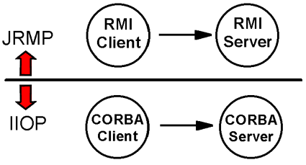
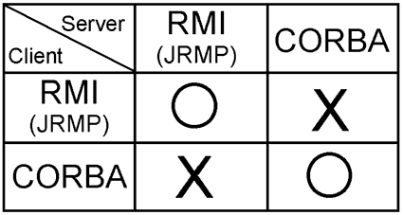
Before RMI-IIOP
Thus there was a dilemma: RMI (JRMP) has the advantage of easy programming, whereas CORBA provides interoperability between multiple programming languages across various platforms. Unfortunately, however, there had not traditionally been a way to use both of these excellent technologies. This is shown by the chart below:

Slide 26
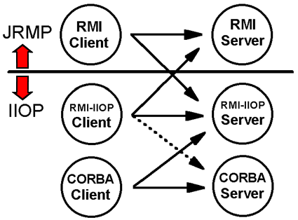
The best of both: RMI AND CORBA
An arrow represents a situation in which a client can call a server.
A server binary (i.e., a class file) created using RMI-IIOP APIs can be exported as either JRMP or IIOP.
You don't have to rewrite its Java source code, or recompile it when changing from JRMP to IIOP, or vice versa.
Same for client

Slide 27
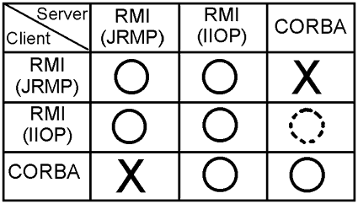
Summary

Slide 28
28
Communication Layers
Slightly different than RMI’ s since the transport protocol is IIOP
Client Application
Server Application
Stub
(Presentation layer)
Tie
(Presentation layer)
ORB – Object Request
Broker
(Session Layer)
ORB – Object Request
Broker
(Session Layer)
IIOP
(Transport Layer)
IIOP
(Transport Layer)
TCP/IP
TCP/IP
Notes:
28

Slide 29
29
Communication Layers
When a client processes a lookup on the name server, it receives from the name server an IOR (Inter Operable Object Reference).
The ORB layer receives the IOR adds something to it and sets up the TCP connection with the server. It then marshals the invocation to the server.
The ORB is also responsible for generating the Context Information (i.e. the data types to be transformed etc.)
The transport protocol creates the IDL.
Notes:
29

Slide 30
30
Communication Layers
IIOP is part of the GIOP (General Inter-ORB protocol) defined in CORBA.
GIOP defines various transport protocols working over various network protocols.
RMI over IIOP is of particular interest to Enterprise Java Beans since the remote object model for EJBs is based on the RMI over IIOP model.
The server class must extend PortableRemoteObject. That inheritance sets up the IIOP protocol as the transport protocol.
Notice that a stub and a tie file is produced when the server program is compiled with a special compiler
Notes:
30

Slide 31
Differences Between RMI and RMI over IIOP
The points here also represent work items necessary to convert RMI (JRMP) code to RMI-IIOP code.
First, because the usual base class of RMI-IIOP servers is PortableRemoteObject.
Next, the class used as the naming service has changed to InitialContext.
After completing the Java coding, you must generate a tie for IIOP, using the rmic compiler with the -iiop option.
Next, run the CORBA CosNaming tnameserv as a name server instead of rmiregistry.

Slide 32
32
Differences Between RMI and RMI over IIOP
CODING DIFFERENCES:
RMI INTERFACE:
import java.rmi.Remote;
import java.rmi.RemoteException;
public interface Payroll extends Remote
{
public double earnings (int id, double hours) throws RemoteException;
}
RMI-IIOP INTERFACE:
import java.rmi.Remote;
import java.rmi.RemoteException;
public interface Payroll extends Remote
{
public double earnings (int id, double hours) throws RemoteException;
}
Notes:
32

Slide 33
33
Differences Between RMI and RMI over IIOP
RMI SERVER IMPORT STATEMENTS:
import java.rmi.*;
import java.rmi.server.*;
RMI SERVER:
public class PayrollImpl extends UnicastRemoteObject implements Payroll {
RMI OVER IIOP IMPORT STATEMENTS:
import java.rmi.*;
import java.rmi.server.*;
import javax.naming.InitialContext;
import javax.naming.Context;
import javax.naming.NamingException;
import javax.rmi.PortableRemoteObject;
RMI OVER IIOP SERVER:
public class PayrollImpl extends PortableRemoteObject implements Payroll {
Notes:
33

Slide 34
34
Differences Between RMI and RMI over IIOP
RMI REGISTRATION OF REMOTE OBJECT:
String ro = "//localhost/money";
PayrollImpl p = new PayrollImpl();
Naming.rebind(ro, p);
RMI OVER IIOP REGISTRATION OF REMOTE OBJECT:
String ro = "money";
PayrollImpl p = new PayrollImpl();
Context initialNamingContext=new InitialContext();
initialNamingContext.rebind(ro, p);
Notes:
34

Slide 35
35
Differences Between RMI and RMI over IIOP
RMI CLIENT IMPORT STATEMENTS:
import java.rmi.*;
import java.rmi.registry.*;
RMI CLIENT REGISTRY LOOKUP:
Payroll p = (Payroll)Naming.lookup("rmi://localhost:1099/money");
RMI OVER IIOP CLIENT IMPORT STATEMENTS:
import java.rmi.RemoteException;
import java.rmi.NotBoundException;
import javax.rmi.*;
import javax.naming.NamingException;
import javax.naming.InitialContext;
import javax.naming.Context;
RMI OVER IIOP CLIENT REGISTRY LOOKUP:
Context ic = new InitialContext();
Object objref = ic.lookup("money");
Payroll p= (Payroll)PortableRemoteObject.narrow(objref,Payroll.class);
Notes:
35

Slide 36
36
Differences Between RMI and RMI over IIOP
RMI CLIENT INVOCATION OF REMOTE SERVICE:
double m = p.earnings(id,d);
RMI OVER IIOP CLIENT INVOCATION OF REMOTE SERVICE:
double m = p.earnings(id,d);
Notes:
36

Slide 37
37
Differences Between RMI and RMI over IIOP
COMPILATION DIFFERENCES:
RMI COMPILE INTERFACE:
javac Payroll.java
RMI COMPILE SERVER:
javac PayrollImpl.java
rmic –v1.2 PayrollImpl
RMI COMPILE CLIENT
javac PayrollClient.java
RMI OVER IIOP COMPILE INTERFACE:
javac Payroll.java
RMI OVER IIOP COMPILE SERVER:
javac PayrollImpl.java
rmic –iiop PayrollImpl
RMI OVER IIOP COMPILE CLIENT:
javac PayrollClient
Notes:
37

Slide 38
38
Differences Between RMI and RMI over IIOP
EXECUTION DIFFERENCES:
RMI START REGISTRY:
ON ITS OWN DOS WINDOW:
rmiregistry
RMI START THE SERVER:
java PayrollImpl
RMI OVER IIOP REGISTRY:
ON ITS OWN DOS WINDOW:
orbd –ORBInitialPort
RMI OVER IIOP START THE SERVER
java -Djava.naming.factory.initial=com.sun.jndi.cosnaming.CNCtxFactory -Djava.naming.provider.url=iiop://localhost:900 PayrollImpl
//Assumes that the naming service was started at default port 900.
Notes:
38

Slide 39
39
Differences Between RMI and RMI over IIOP
EXECUTION DIFFERENCES:
RMI START CLIENT:
java PayrollClient
RMI OVER IIOP START CLIENT:
java -Djava.naming.factory.initial=com.sun.jndi.cosnaming.CNCtxFactory -Djava.naming.provider.url=iiop://localhost:900 PayrollClient
Notes:
39

Slide 40
40
Placement Of Files
IIOP SERVER:
Payroll.class ( the interface file)
PayrollImpl.class (the server file)
_PayrollImpl_Tie.class (tie file)
IIOP CLIENT:
PayrollClient.class (client application)
Payroll.class ( the interface file)
PayrollImpl_stub.class (the stub file).
Notes:
40

Slide 41
41
Placement Of Files
Notice that in case of Callback from the server to the client additional files are needed:
The client acts a server also. Therefore it will have to be compiled with the iiop version of rmic compiler to generate a stub and a tie file for the client as if it were a server.
IIOP SERVER:
Payroll.class ( the interface file)
PayrollImpl.class (the server file)
_PayrollImpl_Tie.class (tie file of server)
PayrollMessage.class (the interface file of the client)
PayrollImplClient_stub.class (the stub class of the client)
Notes:
41

Slide 42
42
Placement Of Files
IIOP CLIENT:
PayrollClientImpl.class (client application)
Payroll.class ( the interface file)
PayrollImpl_stub.class (the stub file of the server)
PayrollMessage.class (the interface file of the client)
PayrollClientImpl_Tie.class (the tie file of the client)
Notes:
42

Slide 43
43
Placement Of Files
A SIMILAR ARRANGEMENT OF FILES IS REQUIRED IF THE CALLBACK TECHIQUE WAS USED WITH A RMI ARCHITECTURE.
THE CLIENT IS ALSO A SERVER AND THEREFORE IT GENERATES ITS OWN STUB AND INTERFACE FILES WHICH HAVE TO BE COPIED ON THE SERVER SIDE.
Notes:
43

Slide 44
44
CORBA
CORBA is a specification given by OMG (Object Management Group). Vendors can implement it.
CORBA stands for Common Object Request Broker Architecture.
It is also used for creating a distributed system of nodes that offer services.
Java has an implementation of CORBA as part of the Standard Edition of the jdk (The API is called Java IDL)
Using CORBA is more complex than RMI or RMI over IIOP.
It requires the knowledge of another language called IDL (Interface Definition Language)
IDL acts as the intermediary between services in various nodes, written in different languages.
Notes:
44

Slide 45
45
COMPARING CORBA TO RMI AND RMI OVER IIOP
Keep in mind that in the case of RMI over IIOP IDL interfaces are generated automatically by the compiler (the programmer does not need IDL to use RMI over IIOP).
Also, in both RMI and RMI over IIOP Java’ s serialization protocol is used automatically to serialize objects that need to be part of the request/response packets. Serialization may have to be externalized in CORBA (created).
Notes:
45

Slide 46
46
COMPARING CORBA TO RMI AND RMI OVER IIOP
Network connections are done by the RMI or RMI over IIOP Frameworks (run time systems). In CORBA explicit programming for the sockets is needed.
The big advantage of CORBA is that CORBA objects can interoperate with objects on other platforms. Thus
A Java client can work with a C++ server and vice versa for example.
Notes:
46

Slide 47
47
COMPARING CORBA TO RMI AND RMI OVER IIOP
RMI only allows Java to Java communications (both the client and the server have to be written in Java)
RMI over IIOP allows interoperability between different languages for the Client and the Server because of the IIOP transport protocol included in RMI over IIOP
Notes:
47

Slide 48
48
CORBA AND IDL
The first step in developing a CORBA application is to define the interfaces to the objects required in your distributed system. To define these interfaces, you use CORBA IDL.
You can implement IDL interfaces using any programming language for which an IDL mapping is available.
Java has specifications that specify a IDL to Java and A Java to IDL data types translation.
Notes:
48

Slide 49
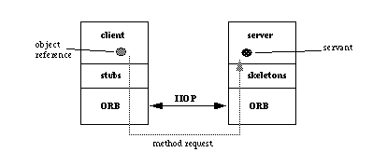
49
CORBA AND ORB
Notes:
49

Slide 50
50
CORBA and ORB
In a CORBA environment, programs request services through an object request broker (ORB), which allows components of distributed applications to find each other and communicate without knowing where applications are located on the network or what kind of interface they use.
ORBs are the middleware that enable client and server programs to establish sessions with each other, independent of their location on the network or their programming interface.
The process of a client invoking a call to an application programming interface (API) on a server object is transparent.
Notes:
50

Slide 51
51
CORBA and ORB
The client issues the call, which is intercepted by the ORB. The ORB takes the call and is responsible for locating a server object that is able to implement the request. Once it has located such an object, the ORB invokes the object’s method and passes it any parameters submitted by the client.
The results are then returned to the client. ORBs communicate among themselves using the General Inter-ORB Protocol (GIOP) or the Internet Inter-ORB Protocol (IIOP) so that any ORB can fulfill any client request on the network.
Notes:
51

